Slide 1
CSE2003 - Data Structures and Algorithms Arrays and Stacks
Oswald c
The class notes are a compilation and edition from many sources. The faculty does not claim intellectual property or ownership of the lecture notes.

Slide 2
Memory Allocation
Memory allocation can be classified as either
Contiguous
Linked
Indexed
Prototypical examples:
Contiguous allocation: arrays
Linked allocation: linked list

Slide 3
Memory Allocation
Contiguous, adj.
Touching or connected throughout in an unbroken sequence.
Meriam Webster
Touching, in actual contact, next in space; meeting at a common boundary, bordering, adjoining.
www.oed.com

Slide 4
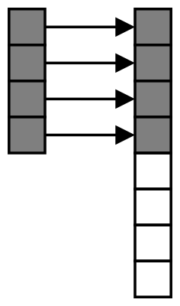
Contiguous Allocation
An array stores n objects in a single contiguous space of memory
Unfortunately, if more memory is required, a request for new memory usually requires copying all information into the new memory
In general, you cannot request for the operating system to allocate to you the next n memory locations

Slide 5

Linked Allocation
Linked storage such as a linked list associates two pieces of data with each item being stored:
The object itself, and
A reference to the next item
In C++ that reference is the address of the next node

Slide 6
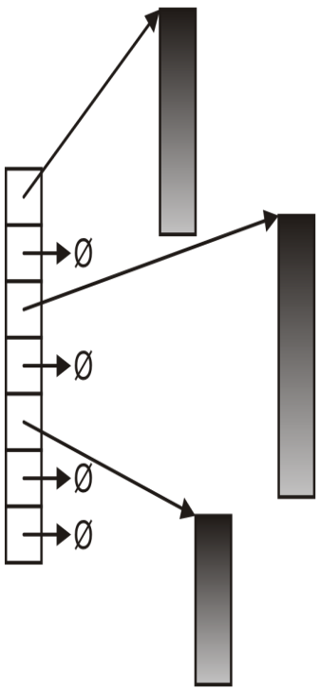
Indexed Allocation
With indexed allocation, an array of pointers (possibly NULL) link to a sequence of allocated memory locations
Used in the C++ standard template library
Computer engineering students will see indexed allocation in their operating systems course

Slide 7
Linear Vs Non-Linear Data Structures
Linear Data Structure - Elements are accessed in a sequential order but it is not compulsory to store all elements sequentially(linear relationships by links).
- E.g. Array, Linked List, Stack, Queue etc.
- data elements can be traversed in a single run only.
- memory is not utilized in an efficient way.
Non-Linear Data Structure - data elements are attached in hierarchical(non-sequential) manner.
- E.g. Trees, Graphs
- data elements can’t be traversed in a single run.
- Efficient memory utilization.

Slide 8
The List ADT
An ordered(linear) collection of items of some element type E.
It is of the form A₀, A₁, A₂, . . ., A_{N−1}. Size of this list is N. The special list of size 0 an empty list.
A_{i} follows (or succeeds) A_{i−1} (i < N) and that A_{i−1} precedes A_{i} (i > 0).
first element of the list is A₀, the last element is A_{N−1}.
The position of element A_{i} in a list is i.
Ref: Fundamentals of DS by C++, MA Weiss

Slide 9
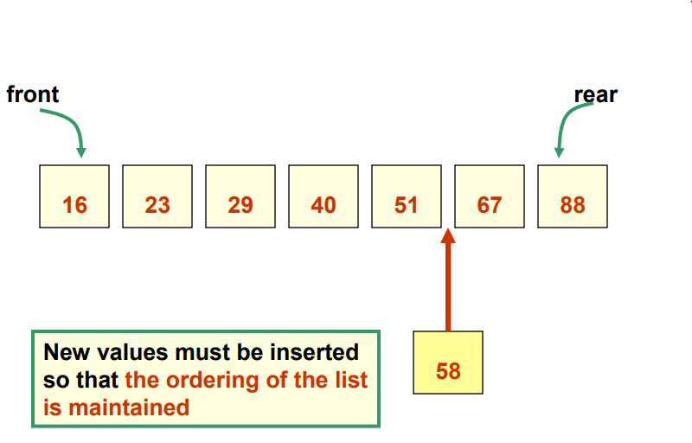
Ordered Lists
Its elements are ordered by some inherent characteristic of the elements
Examples:
- Names in alphabetical order
The elements themselves determine where they are stored in the list
Ref[9-11]: https://www.csd.uwo.ca/courses/CS1027b/notes/CS1027-012-Lists-W12.pdf

Slide 10
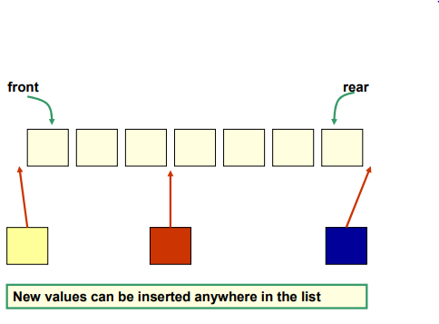
Unordered Lists
The order of the elements in the list is not based on a characteristic of the elements, but is determined by the user of the list.
A new element can be put on the front/rear/middle of the list.
Examples: shopping list, to-do list, …

Slide 11
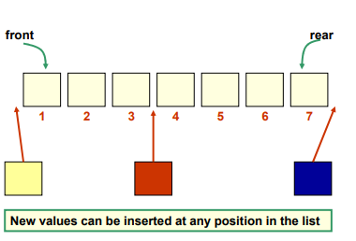
Indexed Lists
Elements are referenced by their numeric position in the list, called its index.
It’s the position in the list that is important, and the user can determine the order that the items go in the list.
Every time the list changes, the position (index) of an element may change.
Example: current first-place holder in the F1- car race

Slide 12
The Common Operations on a List
Operation | Description
add | Adds an element to the list (in the correct place)
remove | Removes and returns the element at a particular index
first | Examines the element at the front of the list
last | Examines the element at the rear of the list
contains | Determines if a particular element is in the list
size | Determines the number of elements in the list
iterator | Returns an iterator for the list’s elements
toString | Returns a string representation of the list
get | Returns a reference to the element at the specified index
indexOf | Returns the index of the specified element

Slide 13
An Array
Arguably the most fundamental data structure
- Other data structures built using arrays
- Computer memory is like a giant array
Convenient way to process large amounts of related data

Slide 14
Array Basics
An array is an indexed collection of data elements of the same type.
1) Indexed means that the array elements are numbered
(starting at 0). 2) The restriction of the same type is an important one,
because arrays are stored in consecutive memory
cells. Every cell must be the same type (and therefore,
the same size).
Types:
A 1- dimensional array is like a list – Generally a ‘Vector’.
A 2-dimensional array is like a table – Generally a ‘Matrix’.
A multidimensional array - Array of arrays.

Slide 15
Declaring 1-D Arrays
Declaration:
datatype_name array_name[size];
Examples:
int age[5]; // an array of 5 integers
float marks[20]; An array of 20 decimals
Initialization:
int array1[5] = {1, 2, 3, 4, 5}; // int array1[] = {1, 2, 3, 4, 5}; is also OK
char array2[5] = {‘a’, ‘b’, ‘c’, ‘d’, ‘e’};
Char array3[] = “India”;

Slide 16
1-D Array – An Example
The array index is generally taken as ‘i’ where
0 ≤ i ≤ size-1
age
35 | 40 | 23 | 12 | 60
age[i = 0]
age[1]
age[2]
age[3]
age[4]
index

Slide 17
1-D Array – An example program
/* Program to calculate the first 20 Fibonacci numbers. */
int i, fibonacci[ 20 ];
fibonacci[ 0 ] = 0;
fibonacci[ 1 ] = 1;
for( i = 2; i < 20; i++ )
fibonacci[ i ] = fibonacci[ i - 2 ] + fibonacci[ i - 1 ];
for( i = 0; i < 20; i++ )
print( i, fibonacci[ i ] );

Slide 18
Searching an element in the array - Linear Search
for (i = 0; i < n; i++) { if (array[i] == key) /* If required element is found */ { printf("%d is present at location %d.\n", key, i+1); break; } } if (i== n) printf("%d isn't present in the array.\n", key);
return 0; }

Slide 19
Modify an element in an array
\\ To change its value, that is to update its value, you could just write
arr[i]= new_value;
\\ If you don’t know the index of that element, you could run a search on it=>
for(int i=0;i<n;i++)
{
if(arr[i]==old_value) { //element found
pos=i;
break; }
}
arr[pos]=new_value;

Slide 20
Copy an array into an another array
int a[100], b[100]; int i, size;
for(i=0; i<size; i++) {
a[i] = b[i];
}
for(i=0; i<size; i++) {
printf("%d\t", b[i]); }

Slide 21
Problems for Practice – 1-D Array
Find the maximum element in an array of n numbers (using functions and recursion)
Reverse the elements in an array into an another array.
Copy the elements in array_1 to an another array array_2.

Slide 22
2-D Arrays
Often data come naturally in the form of a table, e.g., spreadsheet, which needs a two-dimensional array.
Examples:
- Lab book of multiple readings over several days.
- Periodic table.
- Movie ratings by multiple reviewers.
- Each row is a different reviewer.
- Each column is a different movie.

Slide 23
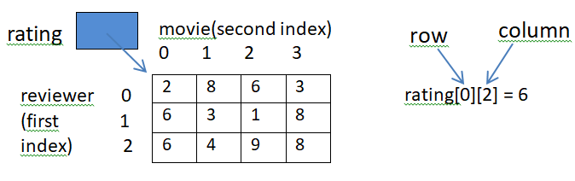
Initialization
Declaration:
datatype_name array_name[row_size][column_size];
Examples:
int array1[2][3]; // an array of 6 integers
float array2[][3] = { {5.0, 6.2, 7.3}, {10.1, 20.0, 30.2} };
int rating[3][4]; // an array of 12 integers

Slide 24
Looping in 2-D Array – Matrix Multiplication
int multiply(int A[][n], int B[][n], int res[][n])
{
int i, j, k;
for (i = 0; i < n; i++)
{
for (j = 0; j < n; j++)
{
res[i][j] = 0;
for (k = 0; k < n; k++)
res[i][j] += A[i][k]*B[k][j];
}
}
}

Slide 25
Problems for Practice – 2-D Array
Print the average rating for the movie in column 3.
Find the sum of each of the two diagonal elements in a square matrix.
Find the Transpose of an array.
Check whether the given 9X9 matrix is a magic square or not.

Slide 26
Multidimensional Array
Multi-dimensional arrays are declared by providing more than one set of square [ ] brackets after the variable name in the declaration statement.
Multi-dimensional arrays do not require the first dimension to be given if the array is to be completely initialized. All dimensions after the first must be given in any case.
Declaration:
data_type array_name [size1][size2][size3] … size[N];
Example:
int mularray[][3][4] = { {{3, 4, 2, 3}, {0, -3, 9, 11}, {23, 12, 23, 2}},
{{13, 4, 56, 3}, {5, 9, 3, 5}, {3, 1, 4, 9}} };

Slide 27
Array Limitations
Arrays
Simple,
Fast
but
Must specify size at construction time
Murphy’s law
Construct an array with space for n
n = twice your estimate of largest collection
Tomorrow you’ll need n+1
More flexible system?

Slide 28
A Stack ADT
A stack is a list in which insertions and deletions are allowed only at the front of the list.
Invented by Friedrich Bauer in 1957.
Front of Stack – “Top”.
Behaves like a LIFO(Last In First Out) list since the last item inserted is the first item removed.
Searching or accessing to anywhere else in the list is not supported.
Push
Pop

Slide 29

Stacks in Real World
http://www.bowdoin.edu/~ltoma/teaching/cs210/fall08/Slides/210-stacksAndQueues.pdf

Slide 30
Stack ADT – Basic operations in a Stack
create() ---> s: Stack, empty stack
destroy() ---> Destroys(removes from memory) a stack
isEmpty(s) ---> b:Boolean, Return true if the stack is empty
else return false
isFull() ---> b:Boolean, Return true if the stack is full
else return false
top(s) ---> v: Data, if s is not empty
else return false
push(s,v) ---> t: Stack, Add new item to the top of the stack
pop(s) ---> t: Stack, if s is not empty
else error

Slide 31
Applications of Stack
evaluating arithmetic expressions
recursion removal
parsing context-free languages
function call management
traversing trees and graphs (such as depth first traversals)

Slide 32
Stack: An Example
Top = -1
Top = 0
Top = 1
6
8
6
create()->[]
empty stack
push([],6)
push([6],8)
Top = 2
Top = 1
Top = 2
3
8
6
8
6
15
8
6
15
8
6
push([6,8],3)
pop([6,8,3])
push([6,8],15)
pop([6,8,15]) -> 15

Slide 33
Stack ADT Pseudocode
#ifndef _STACK_H
#define _STACK_H
#define SIZE 100
#define ERROR 0
#define OK 1
typedef struct {
int Array[SIZE] ;
int tos ; //top of stack
} stack ;
void init(stack *) ;
int push(stack * , int) ;
Stack.h
int pop(stack *) ;
int top(stack *, int *) ;
int isEmpty(stack *) ;
int isFull(stack *) ; // For finite size
#endif

Slide 34
Implementation:
Stack.c
#include "stack.h"
void init(stack *s) // stack.c – To create a stack
{ s->tos = -1;}
int isFull(stack *s)
{ return s->tos == SIZE-1;}
int isEmpty(stack *s)
{ return s->tos == -1;}
int push(stack *s, int n) { // Pushing an element in stack
if(isFull(s)) {

Slide 35
printf("The STACK is full \n”);
return ERROR ;
}
s->data[++s->tos]=n;
return OK ;
}
int Pop(stack *s) { // Removing an element
if(isEmpty(s)) {
printf("The STACK is empty\n");
return ERROR ;
}
s -> tos-- ;
return OK ;
}

Slide 36
Implementation (cont’d)
int Top(stack *s , int *val) { // Retrieving top most element
if(isEmpty(s)) {
printf("The STACK is empty\n") ;
return ERROR ;
}
*val = (s -> data[s -> tos]) ;
return OK ;
}

Slide 37
Stack Implementation
Two Ways of creating a Stack:
1) Array Implementation of a stack
typedef struct {
int Array[SIZE] ;
int tos ;
} stack ;
3 | 5 | 7 | 10
Top of stack

Slide 38
Linked-List implementation of a Stack
A linked list provides fast inserts and deletes at head
==> keeps top of stack at front
struct StackNode
{
StackItemType item;
StackNode *next;
};
StackNode *top_ptr; // pointer to first node in the stack
 | 6
 | 5
 | 2
 | 4
Top of stack

Slide 39
Array vs Linked List Implementation
Array
simple and efficient
assume a fixed capacity for array
- if CAP is too small, can reallocate, but
expensive.
- if CAP is too large, space wastage.
Lists
no size limitation.
extra space per element.
Conclusion
- When know the max. number of element, use arrays.

Slide 40
Time and Space Complexities of Stack
Method | Time | Space
size() | O(1) | O(1)
isEmpty() | O(1) | O(1)
isFull() | O(1) | O(1)
top | O(1) | O(1)
push | O(1) | O(1)
pop | O(1) | O(1)

Slide 41
Application 1: Infix to Postfix expression
When an operand is read, output it
When an operator is read
–Pop until the top of the stack has an element
lower precedence
–Then push it
When ) is found, pop until we find the matching (
( has the lowest precedence when in the stack
but has the highest precedence when in the input
When we reach the end of input, pop until the stack is empty

Slide 42
Converting Infix to Postfix – An example
Output Postfix | Stack | Input Infix Expression
 |  | a+b*c*d-e
a |  | +b*c*d-e
a | + | b*c*d-e
ab | + | *c*d-e
ab | +* | c*d-e
abc | +* | *d-e
abc* | + | *d-e
abc* | +* | d-e
abc*d | +* | -e
abcd** | + | -e
abcd**+ |  | -e
abcd**+ | - | e
abcd**+e | -
abcd**+e-

Slide 43
Infix to Postfix Expression - Try it!
3+4*5/6
(300+23)*(43-21)/(84+7)
(4+8)*(6-5)/((3-2)*(2+2))

Slide 44
Application 2: Evaluating Postfix Expression
create an empty stack that holds the type of values
being computed
for each token tok in the string {
if tok is an operand
stack.push(tok);
else if tok is an operator {
let op denote the operation that tok provides
stack.pop(right_operand);
stack.pop(left_operand);
result = left_operand op right_operand;
stack.push(result);
}
}

Slide 45
Application 2: Evaluating Postfix Expression
Input: 8 6 + 9 2 - / 5 * 7 +
Stack (right end is top) | Input Remaining | Action to Take
(empty) | 8 6 + 9 2 - / 5 * 7 + | push 8 on stack
8 | 6 + 9 2 - / 5 * 7 + | push 6 on stack
8 6 | + 9 2 - / 5 * 7 + | 8+6 = 14; push on stack
14 | 9 2 - / 5 * 7 + | push 9 on stack
14 9 | 2 - / 5 * 7 + | push 2 on stack
14 9 2 | - / 5 * 7 + | 9 - 2 = 7; push 7 on stack
14 7 | / 5 * 7 + | 14 / 7 = 2; push 2 on stack
2 | 5 * 7 + | push 5 on stack
2 5 | * 7 + | 2*5 = 10; push 10 on stack
10 | 7 + | push 7 on stack
10 7 | + | 10+7=17; push 17 on stack
17 |  | end-of-input; answer = 17

Slide 46
Evaluating Postfix Expression – Try it!
300 23 + 43 21 -* 84 7 + /
4 8 + 6 5 -* 3 2 –2 2 + * /

Slide 47


